Slide 1
FIRM INTERNATIONALIZATION MASAN CONSUMER
Group 3 - Class 23C1BUS50305211

Slide 2
GROUP MEMBERS
NAME
STUDENT ID
1
Le Nguyen Chau Anh
31221024891
2
Nguyen Mai Anh
31221027013
3
Nguyen Thanh Hai
31221024999
4
Vo Duc Nghia
31221025137
5
Dinh Bao Ngoc
31221024932

Slide 3
TABLE OF CONTENTS
01
02
INTRODUCTION OF
MASAN CONSUMER
INTERNATIONAL COMPETITIVENESS &
MODE OF THE INTERNATIONALIZATION
03
04
THE GLOBAL
STRATEGIC DIRECTION
RECOMMENDATION

Slide 4
01
INTRODUCTION
MASAN CONSUMER
HISTORY
SNAPSHOTS
Introduction of the focal firm

Slide 5
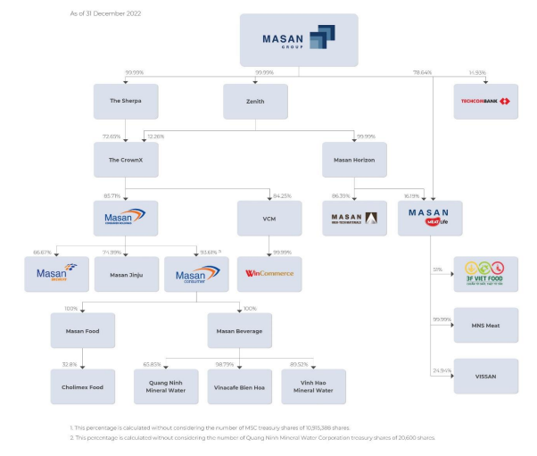

Slide 6

1.1. OVERVIEW
Masan Consumer Corporation was established in 1996 as a subsidiary of Masan Consumer Holdings Co., Ltd - a subsidiary of Masan Group JSC (Masan Group), specializing in manufacturing and distributing a wide range of food and beverage products. Its products include soy sauce, fish sauce, chili sauce, instant noodles, instant coffee, instant cereals, and bottled beverages. Masan Consumer has expanded its business and exported its products to many countries around the world.

Slide 7
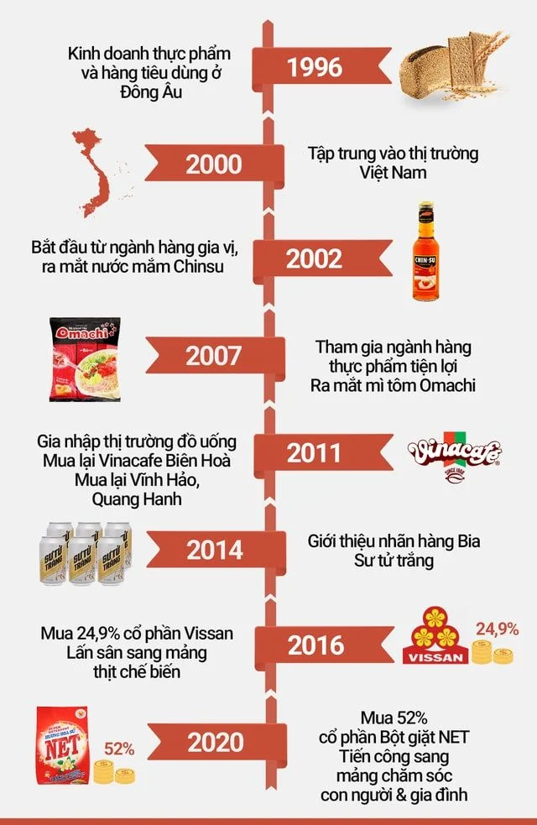
1.2
BUSINESS HISTORY
1996
2000
Viet Tien Technology - Industry - Trade Joint Stock Company
Minh Viet Import - Export and Industry Joint Stock Company
2002
Launched first product : Chin-Su soy sauce
2003
Merged : Masan Industry and Trade Joint Stock Company.
2008
2011
Change name to Masan Food JointStock Company (Masan Food)
Change name to Masan Consumer JointStock Company (Masan Consumer) and keep until now.

Slide 8
1.2. BUSINESS HISTORY
Firm milestones on international business
9/2016
8/2019
NOW
Within 9 months from the date, the contract with Singha was signed, Masan launched a fish sauce product called "Chin-Su Yod Thong" to the Thai market.
Chin-Su chili sauce event was officially presented and imported into the Japanese market within the framework of the "Vietnam Food Day" in Osaka city by the Vietnamese Consul General organization
Masan Consumer has expanded its business and exported its products to many countries around the world. Examples include the United States, Canada, France, Russian Federation, CzechRepublic, Poland, Germany, China, Middle East, Asia, Laos, and Cambodia.

Slide 9
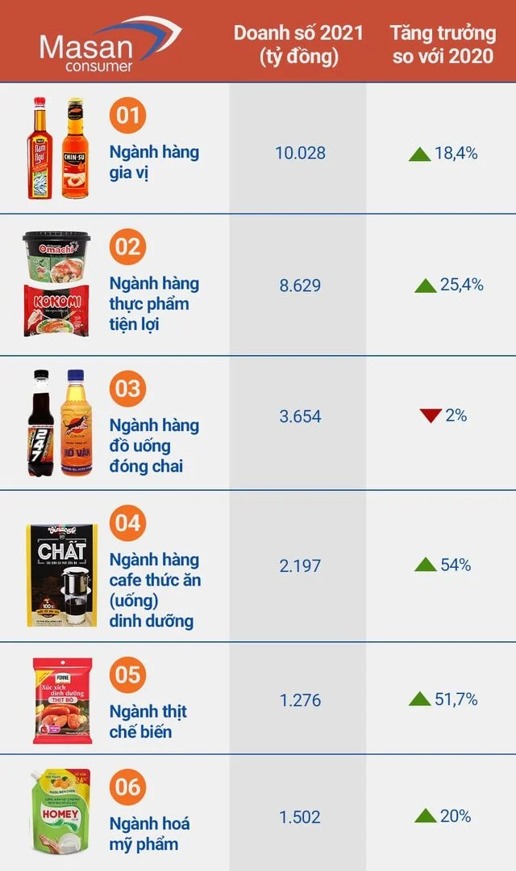
1.3. BUSINESS SNAPSHOTS
CURRENT
Today, Masan Consumer has become a billion-dollar revenue company with a diverse and trusted portfolio of branded products in the consumer goods (“FMCG”) sector.
In Vietnam, Chin-Su is leading the chili sauce market with a 60% market share. In addition to the Japanese market, this product has been exported to North America, Europe, Australia, China, Korea...

Slide 10
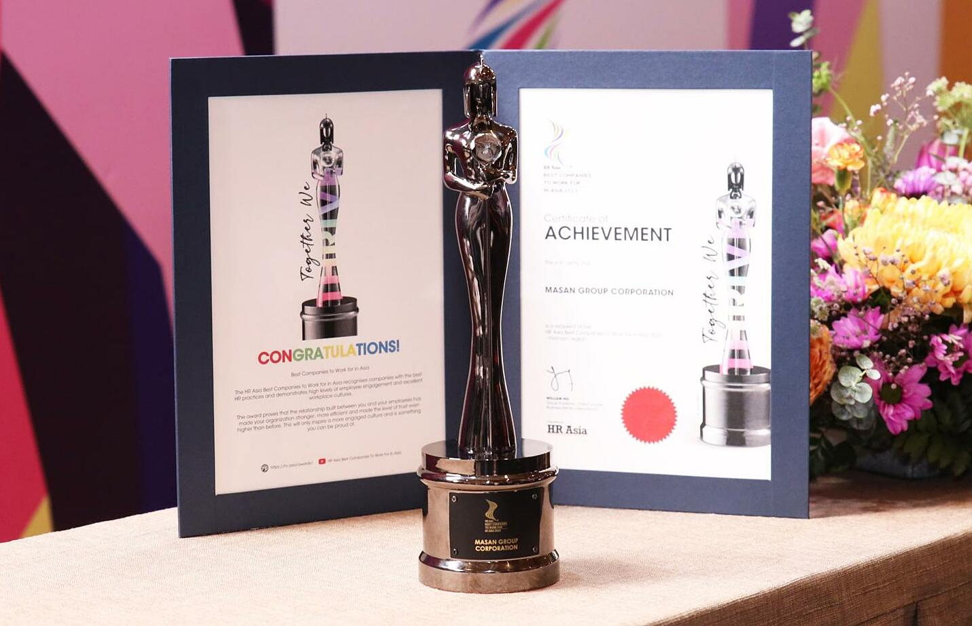
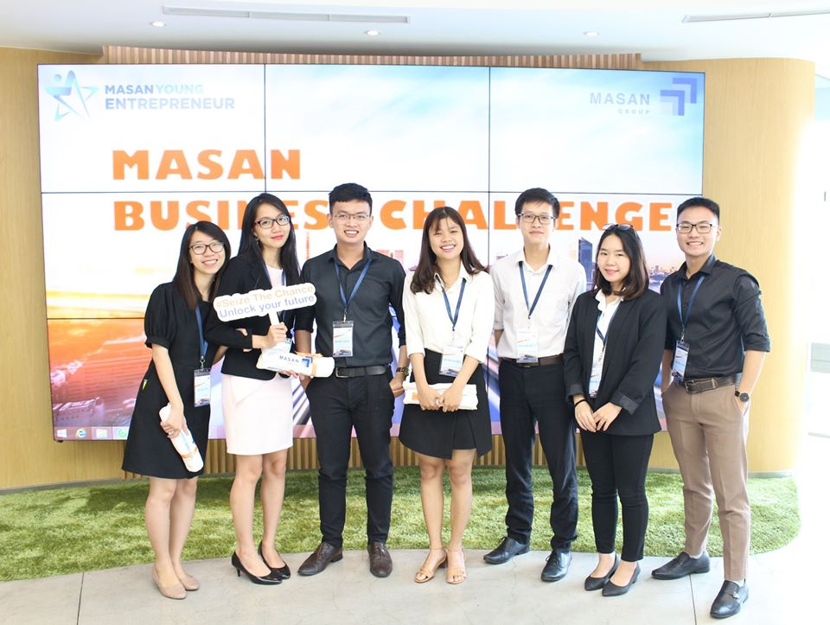


1.3. BUSINESS SNAPSHOTS
EMPLOYEES
Best Company to Work for in Asia 2023
HR Asia Diversity, Equity, and Inclusion
Activities are carried out to help employees develop and reach their full potential
Nearly 6,000 employees have a "Masan Way" spirit

Slide 11
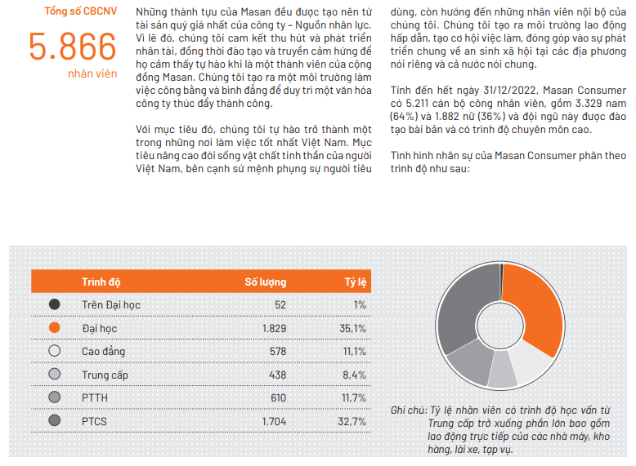
By the end of December 31, 2022, Masan Consumer has 5,866 employees, including 3,329 men (64%) and 1,882 women (36%), and this team is well-trained and highly qualified.

Slide 12

1.3. BUSINESS SNAPSHOTS
MARKETS
Dominating market share in many fast-moving consumer goods segments

Slide 13
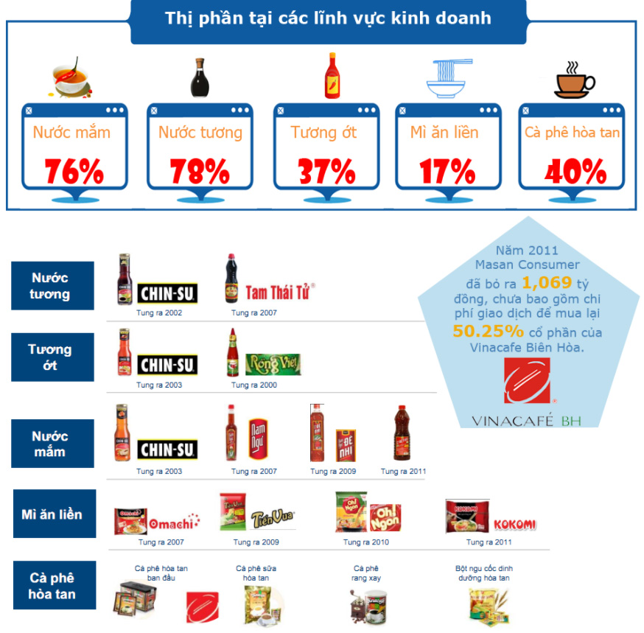
The largest market share in the fish sauce industry, second largest market share in the instant noodle industry, rank first in the instant coffee industry.
Wide distribution network throughout Vietnam with about 180,000 food sales points and 170,000 beverage sales points

Slide 14
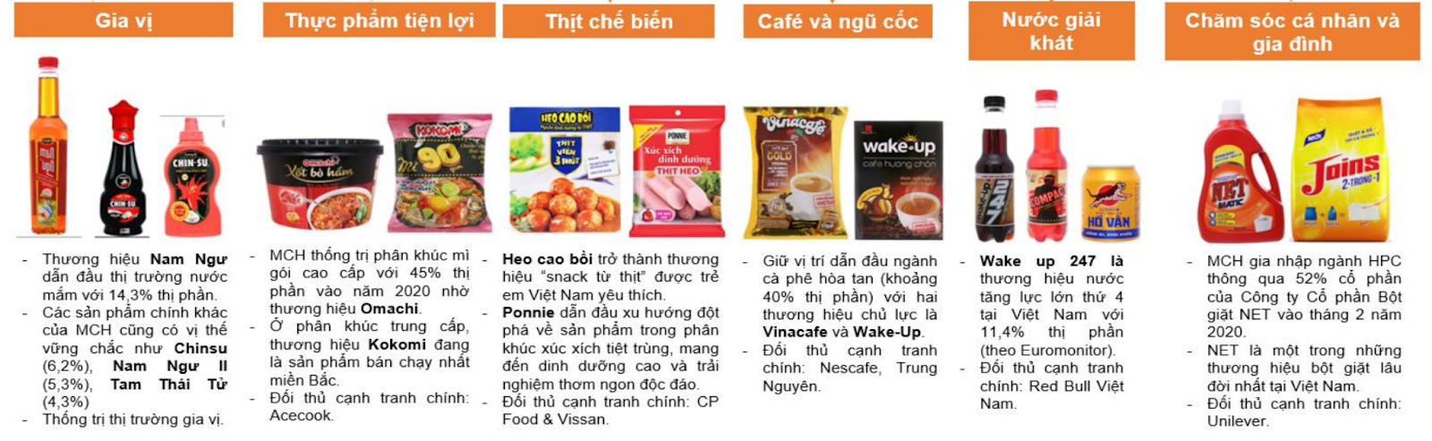
1.3. BUSINESS SNAPSHOTS
PRODUCTS
Possessing a widespread distribution system with a large customer base
Diverse product portfolio

Slide 15

1.3. BUSINESS SNAPSHOTS
PRODUCTS
Possessing a widespread distribution system with a large customer base
Diverse product portfolio
Own strong brands

Slide 16
02
INTERNATIONAL COMPETITIVENESS &
MODE OF THE INTERNATIONALIZATION
COMPETITIVENESS
MODE

Slide 17
MASAN CONSUMER’S STRENGTHS
BRAND
1
6
EMPLOYEES
Strong brand in the market
High qualified and experienced staffs
TECHNOLOGY
FINANCE
2
5
Technology in production is more and more modern and developed
Strong financial resources
PRODUCTS
3
4
DISTRIBUTION
Products with a variety of categories
Large product distribution system

Slide 18
MARKET SELECTION
The company products are exported into 11 international markets

Slide 19
TIMING OF ENTRY
Masan Consumer is not a pioneer enterprise entering international markets.
WHAT ARE THE BENEFITS OF NOT BEING A PIONEER ?
Avoid the disadvantages of first movers
Get information about market, the need of similar products
Resolution of market uncertainty
Businesses can observe and learn from the mistakes of previous businesses
Do not have to bear exploration costs in new market

Slide 20
SCALE OF ENTRY
YES,
BUT
Masan Consumer take the common path which is start small by exporting
- Allow to learn about a foreign market before deciding whether to enter on a large scale and how best to enter.
- Entering on a small scale is less costly
- Minimizes the risks associated with a large entry, limit potential losses
- More difficult to build market share
- Lack of commitment thus not attract to customers and distributors

Slide 21
MODE OF ENTRY
The way to enter the market of Masan Consumer is in the form of export
The company still mostly focus on home market and only decided to enter with a small scale so export is a suitable way
VISION AND STRATEGY
WHY ?
Avoiding the cost of directly competing with other famous international brand or the local brands
Exporting is cheaper than Wholly owned subsidiaries or Joint ventures
COST
COMPETITION

Slide 22
THE GLOBAL
STRATEGIC DIRECTION
03
MAJOR ACT
INT STRATEGY

Slide 23
LOCATION OF MAJOR ACTIVITIES
— HOME
MACROENVIRONMENT | OPPORTUNITIES |  |  |  | THREATS
ECONOMIC | The economy is growing → Increasing personal income |  |  |  | Inflation has slightly increased
POLITICAL | Stable and robust politics create favorable conditions for the development of Masan. |  |  |  | Stability in politics attracts the attention of multinational companies and increases international competition among them.
CULTURAL | Vietnam ranks in the top 3 countries globally for instant noodle consumption. |  |  |  | Differences in taste preferences and consumer culture.
NATURAL | Easy transportation and import/export opportunities. High consumer demand due to floods in the Central region. |  |  |  | Floods and hilly terrain make transportation difficult.
TECHNOLOGICAL | Advancements in science and technology are on the rise |  |  |  | Quality control in Vietnam is not yet at a high level.

Slide 24
LOCATION OF MAJOR ACTIVITIES
— HOME
MICROENVIRONMENT | OPPORTUNITIES |  |  |  | THREATS
COMPETITORS | Drive development and innovate products to align with societal trends, ensuring not to lag behind competitors in the race. |  |  |  | The fast-moving consumer goods (FMCG) industry faces fierce competition from strong rivals like Vina AceCook and Asia Foods.
CUSTOMERS | A growing number of loyal customers due to the company's prominence and the rapid increase in people's stable incomes. |  |  |  | Customers have many choices when it comes to fast-moving consumer goods from various companies.
SUPPLIERS | Building sustainable relationships with suppliers. |  |  |  | The pursuit of low-cost suppliers may lead to potential issues with input materials not meeting quality standards.
SUBTITUTE PRODUCTS | By researching and improving existing products, the business can gain a competitive edge in the market, helping to grow its market share. |  |  |  | Due to numerous substitute products, competition is high, and profit margins may decrease. The cost of research and development also tends to increase.
POTENTIAL COMPETITORS | The presence of additional competitors can motivate the company to operate more efficiently. Moreover, analyzing potential competitors can help Masan identify risks in the industry. |  |  |  | Potential competitors can emerge at any time, and there may not be specific strategies in place to deal with them.

Slide 25
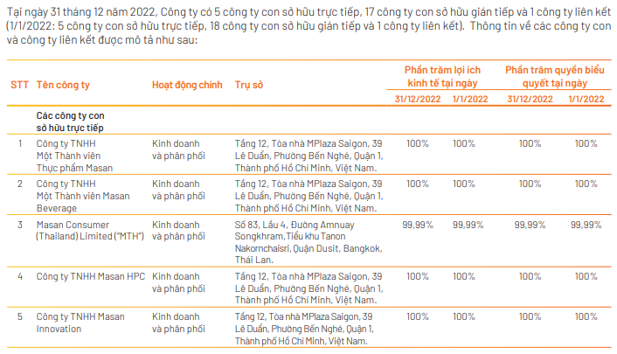
LOCATION OF MAJOR ACTIVITIES
— ABROAD
In 2016, having realized the potential of the Thai market, the business established its business and distribution activities in Thailand, establishing Masan Consumer (Thailand) Limited.

Slide 26
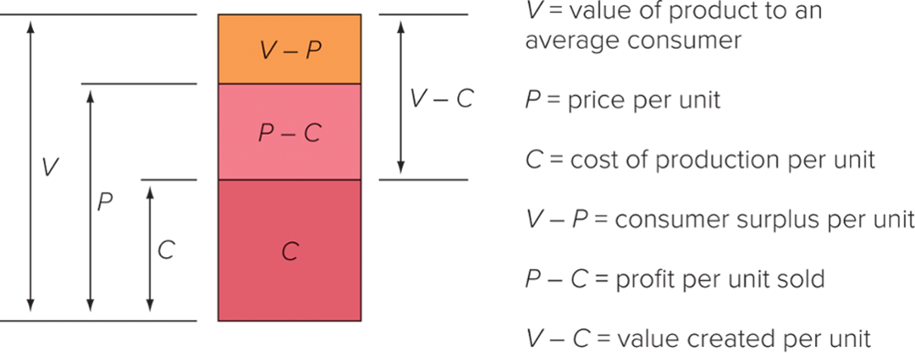
LOCATION OF MAJOR ACTIVITIES
— ABROAD
Pursuing such a strategy can realize regional economic advantages, which are savings that arise from performing value-creating activities in the optimal location for that activity. This may reduce the cost of value creation and help the firm achieve a low-cost position, and/or may enable the firm to differentiate its products from those of its competitors.

Slide 27
INTERNATIONAL STRATEGIC DIRECTION
LOCALIZATION
STRATEGY
Masan first focused on developing its market at Vietnam
After gaining superb achievements at its home market, the company expands it market
Masan Consumer adopt
Embracing cultural sensitivity, linguistic expertise, and respect for local nuances
Customizing the firm’s goods or service matching taste and preference of consumer in new market
Thus, Masan can increase the product value and profitability

Slide 28
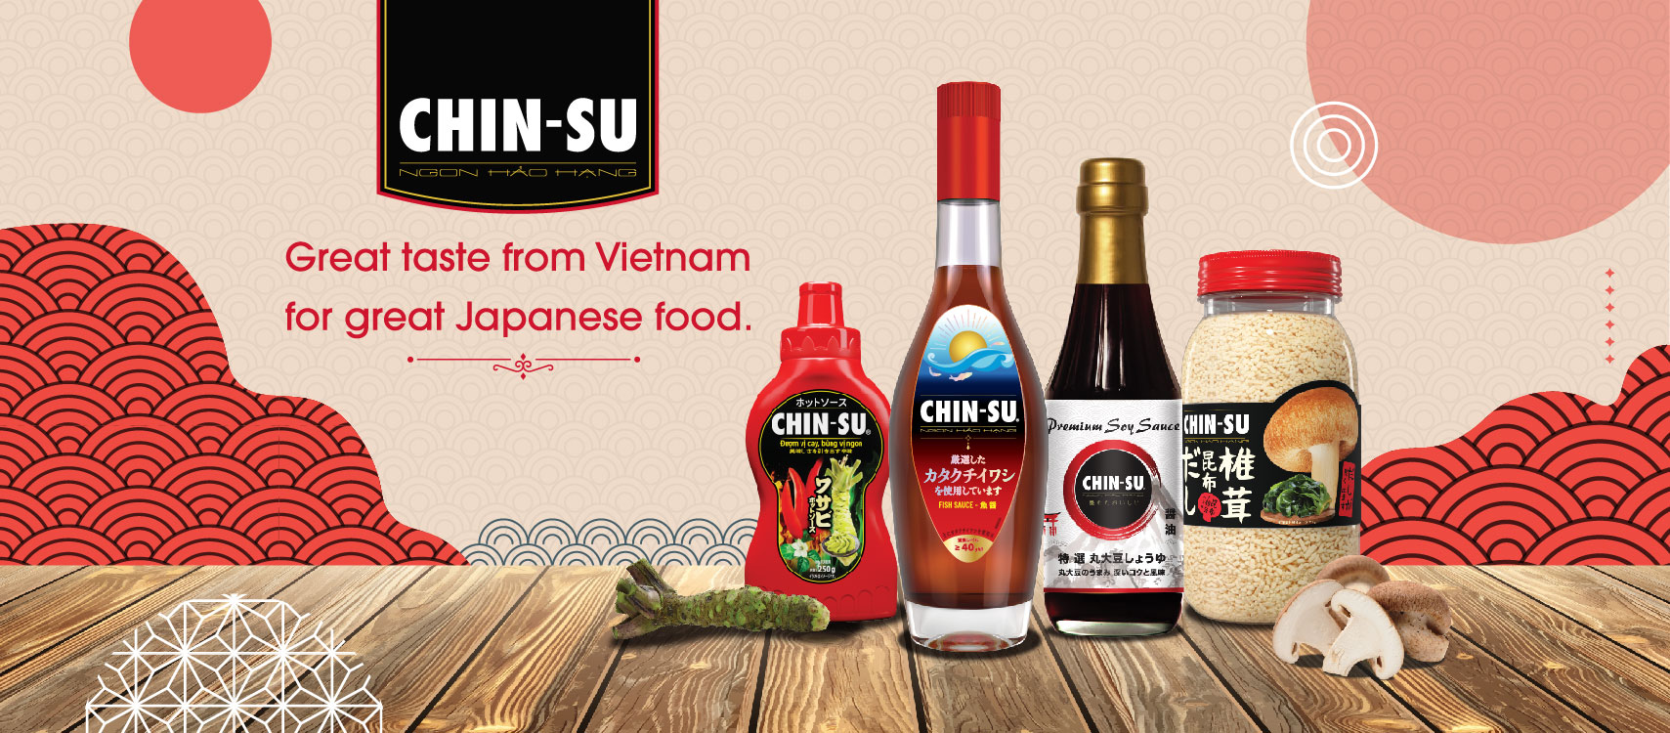
E.G. DIFFERENT PACKAGING IN DIFFERENT LANGUAGES AND CUSTOMIZED PRODUCTS FOR EACH COUNTRY

Slide 29

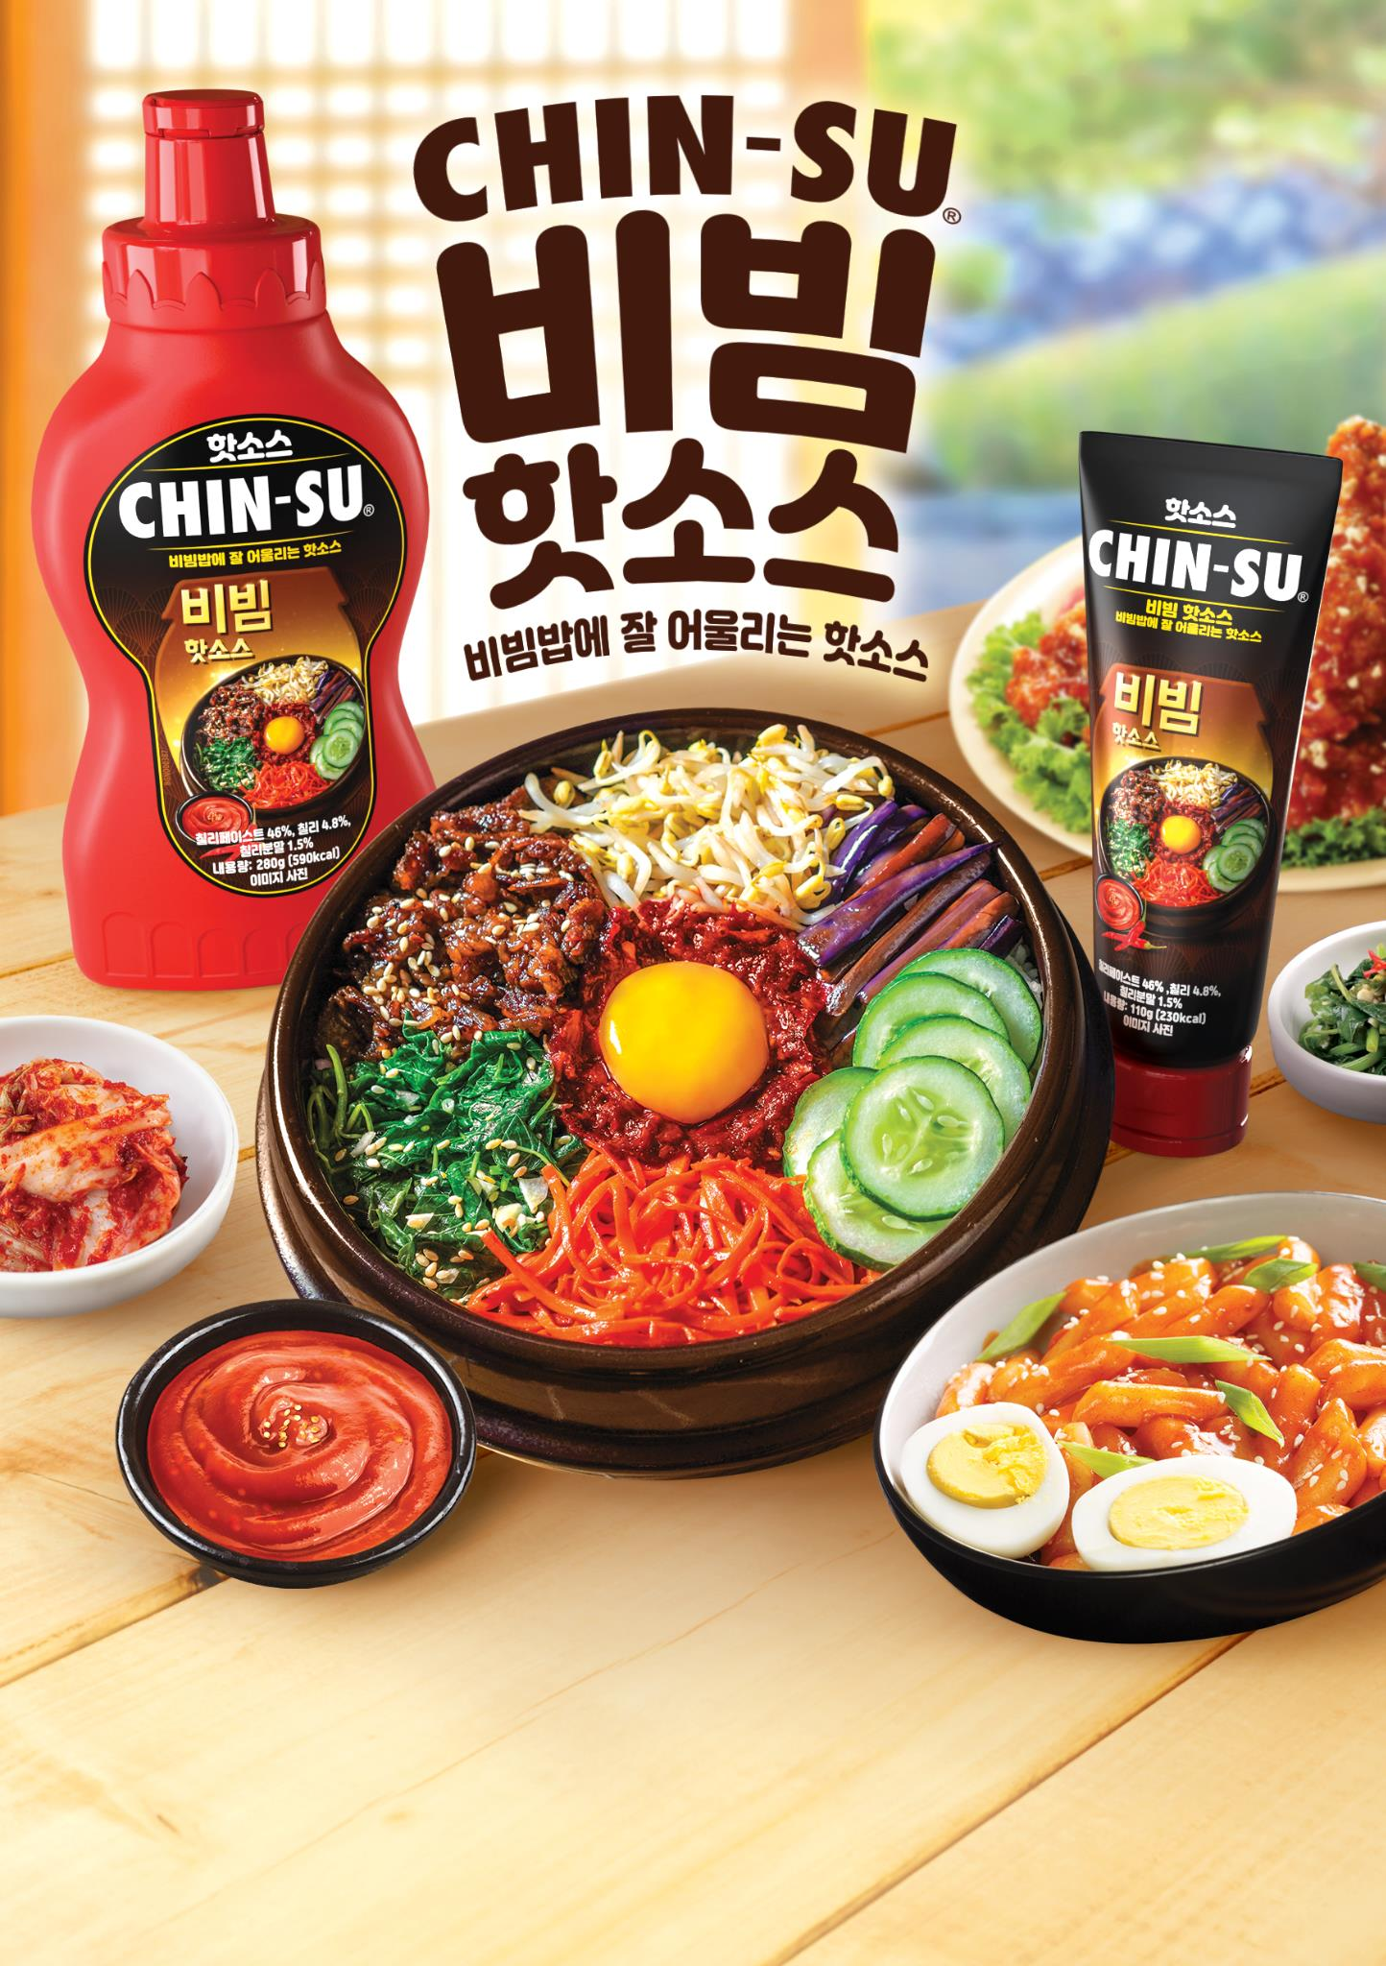
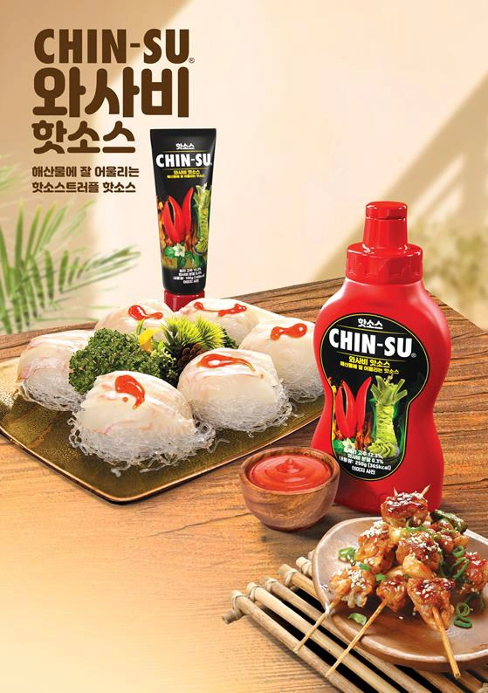
E.G. DIFFERENT PACKAGING IN DIFFERENT LANGUAGES AND CUSTOMIZED PRODUCTS FOR EACH COUNTRY

Slide 30
STRATEGIC CHOICE: DISADVANTAGES
Not taking advantages of Economies to scale
Paying taxes and tariffs each time exporting
Different strategy in different markets
Supply chain systems can be easily affected by external factors like Covid,...
Increase the products’ prices

Slide 31
STRATEGIC CHOICE: ADVANTAGES
Meet the taste and preference of people in different markets
Reduce the time it takes for potential customers to connect with your offering
Builds trust and brand loyalty with local audiences by making your brand relevant to them
Improves customer satisfaction with customized experiences
Provides a competitive edge when facing local and global competitors
Chances of creating superb products

Slide 32




STRATEGIC ALLIANCE
On Masan Consumer's journey to go global, it had formed strategic alliances with many big company in the food and beverage industry.
Help shorten the time to market penetration:
Masan can take advantage of Singha's distribution channel
Overcoming Competition: The companies, when together can overcome a large competitor, especially at Thai market
Improve company public image
Make use of Singha's market information and the company's experience
Innovating beyond current capabilities: together bring out new products

Slide 33
04
RECOMMENDATION
RCM
04

Slide 34
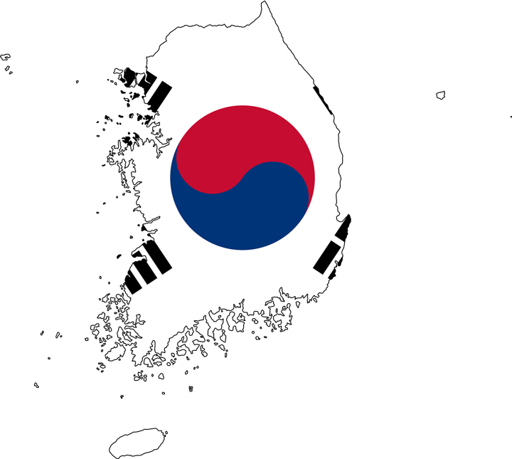
INCREASE THE SCALE OF MARKET ENTRY
Entering the spice products into a potential market for businesses
SOUTH KOREA

Slide 35
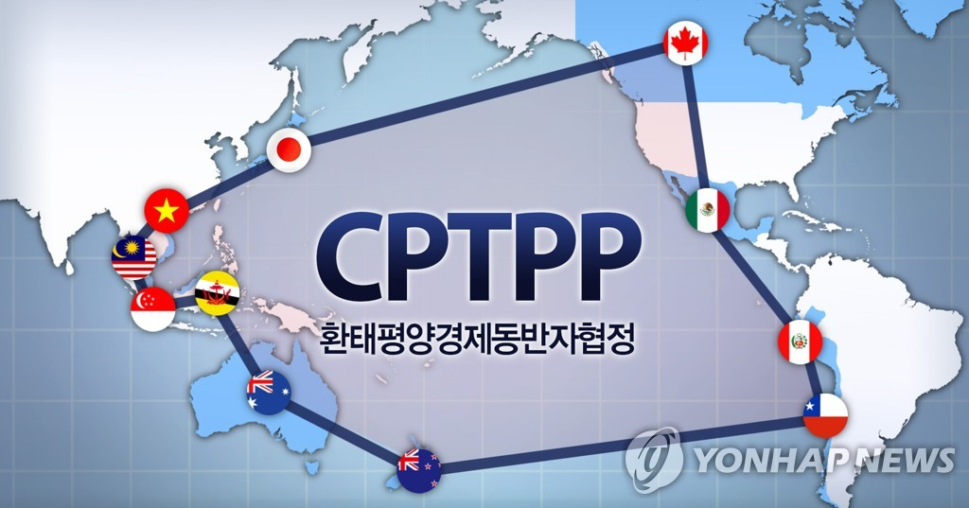
When Korea decided to sign the CPTPP trade agreement, it created greater opportunities than ever for Vietnamese businesses that want to expand their business scale.

Slide 36
LOCALIZATION
—INTERNATIONAL STRATEGIC DIRECTION
With this strategic direction, Masan has to improve products, add new unique flavors, and upgrade packaging designs to suit Korean needs.

Slide 37
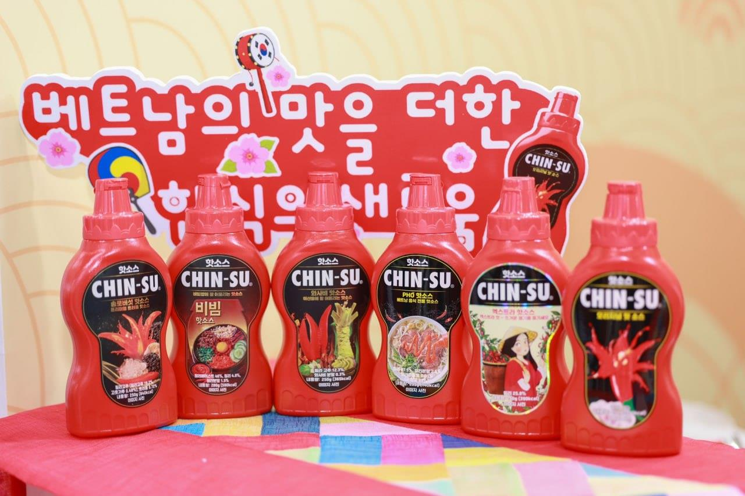
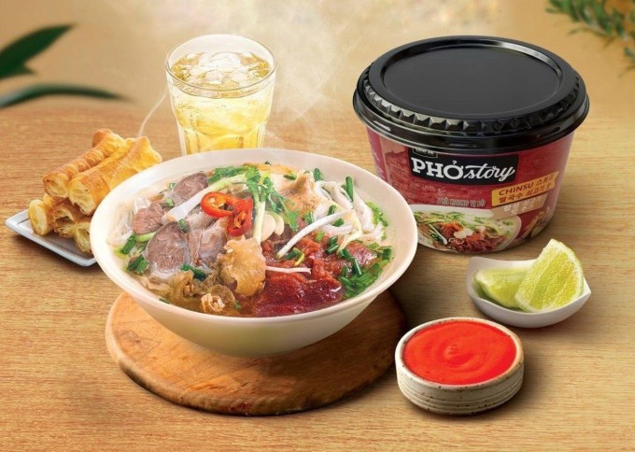
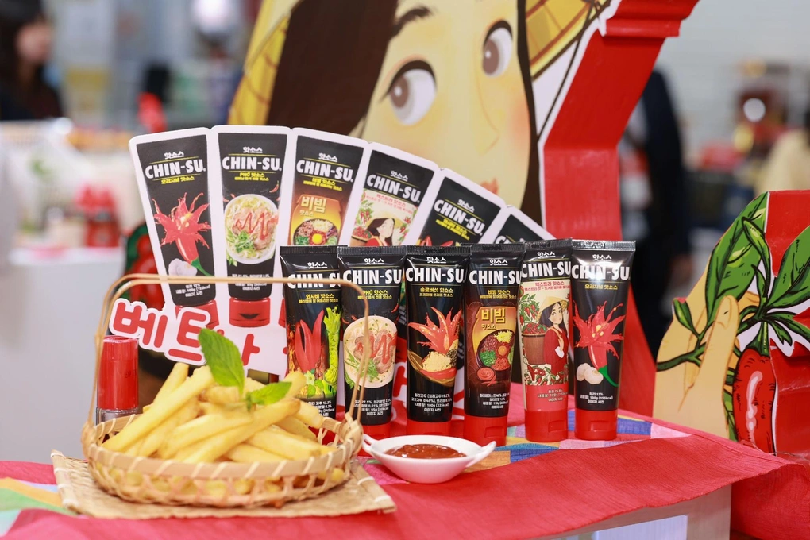
Recently, Masan Consumer has accelerated its 'Go Global' strategy when officially introducing the Chin-su Pho and Spice Collection at the Seoul Food 2023 event.

Slide 38
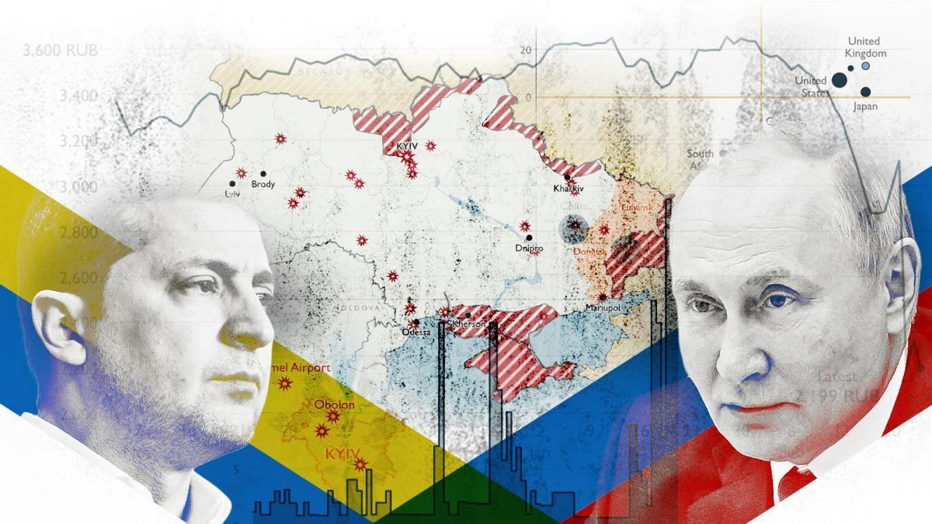

PRICING STRATEGY
IN THE EARLY STAGE
This is an opportunity for Masan to implement a low-cost strategy in the context that the Korean Won has been priced down since 2022 as well as the impact of the Russia - Ukraine war. As a result, the price of Korean essential goods increased. Masan is confident that it can produce products with similar quality but at lower prices than any competitors in the same segment. With strong resources in the financial, supply chain and factories system in VietNam, Masan can maximize the scale production in order to take advantage of economies of scale to reduce costs. Thereby creating a big competitive advantage over competitors and increasing the revenue.

Slide 39
PRICING STRATEGY
IN THE LATER STAGE
Slowly increase product prices to match product quality, goals and competitive position. Because Korean people have strict requirements for quality as well as lack sympathy for products with prices that are too low; After successfully penetrating at a low price, Masan needs to use the market price method to raise prices reasonably, to increase profits, and at the same time confirm product quality in the market.

Slide 40
DISTRIBUTION STRATEGY
Using exclusive distribution strategy with indirect distribution method
DISTRIBUTION CHANNEL STRUCTURE
Producer → Distributor → Retailer → Consumer
We recommend Masan to choose only one distributor and distribution channel level 2 to avoid lengthening distribution channels in Korea due to regional differentiation and the gap between rich and poor as well as helping the product reach consumers faster without having to go through many other intermediaries.
Masan can implement a joint venture or acquisition strategy with a Korean business to participate in distributing products.

Slide 41
DISTRIBUTION STRATEGY - DISTRIBUTION CHANNEL
Advantages
- Both Masan Consumer and distributors can focus on their specific tasks, which creates specialization. This contributes to increasing productivity, the number of products produced as well as minimal production costs and increased profits.
- Use distributors' localization advantages, including relationships with retailers to strengthen the Masan brand in the market.
- Masan Consumer is a reputable company in its home market with strong financial resources. However, Masan Consumer lacks experience and management ability in Korea - a new and large market, so it chooses a distribution system for its products with a single channel helps manage distribution quality better and will meet consumer needs as quickly as possible.
Besides, this strategy allows Masan to have control over promotion policies, services, prices,...

Slide 42
THANKS!

